Slide 1
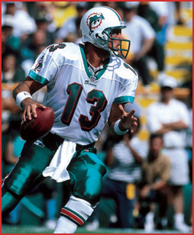
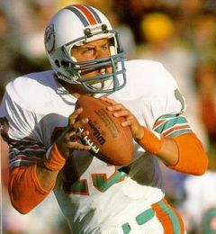
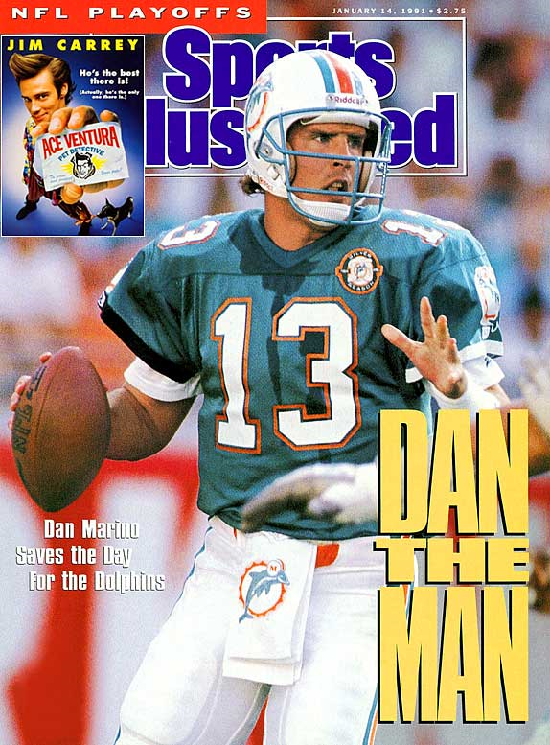
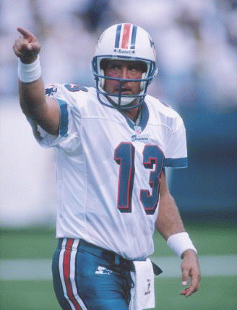
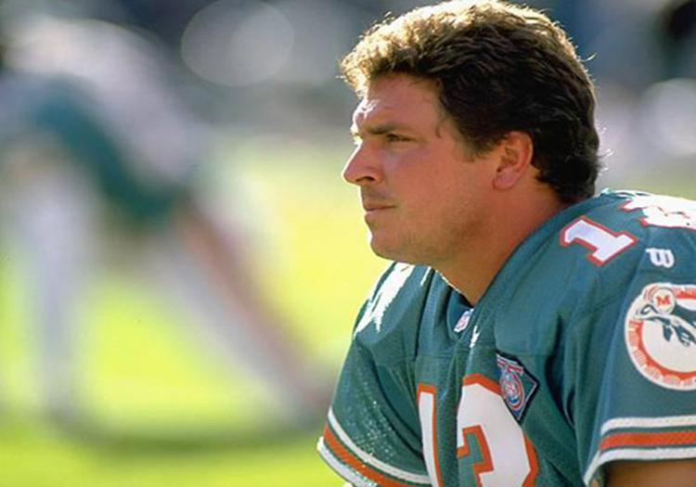
Dan Marino
Unlucky Number 13

Slide 2
Brief History
Dan Marino was the QB for the Miami Dolphins from 1983 to 1999
He was inducted into the Hall of Fame in 2005
Holds the record for must touchdown passes, ever, 420.
However, Dan Marino never won a Super Bowl and only played in one super bowl his entire career.
Why wasn’t he able to win?
Is a good quarterback essential to winning a Super Bowl?

Slide 3
QB Ratings
The QB Rating System takes into account four things
completion percentage,
yards/attempt,
touchdowns/attempt,
and interceptions/attempt

Slide 4
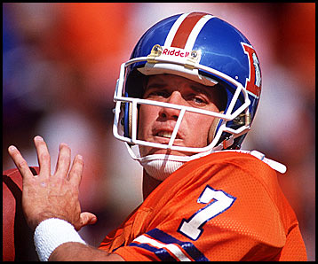
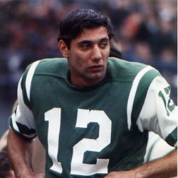
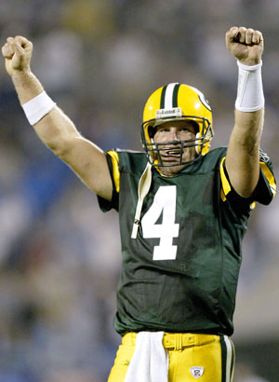
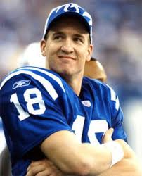
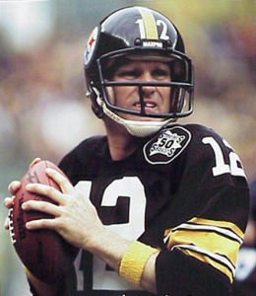
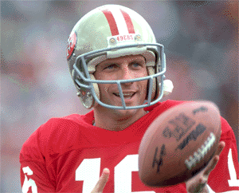
COMPARED TO…
Joe Namath
John Elway
Bret Favre
Peyton Manning
Terry Bradshaw
Joe Montana
Trent Dilfer

Slide 5
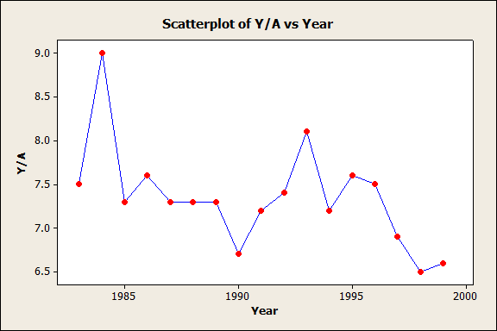
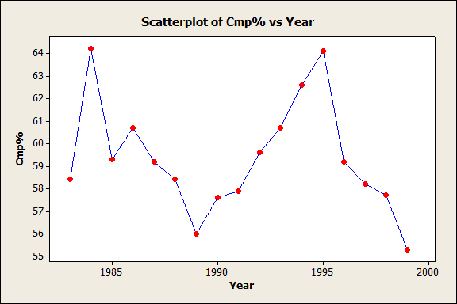
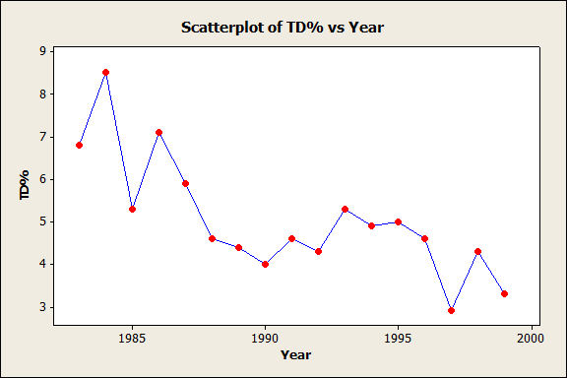
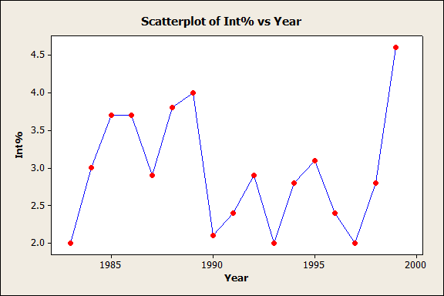
Dan Marino: Breakdown
RATING
Mean SE Mean StDev Minimum Q1 Median Q3 Maximum
86.69 2.22 9.15 67.40 80.75 85.80 91.65 108.90

Slide 6
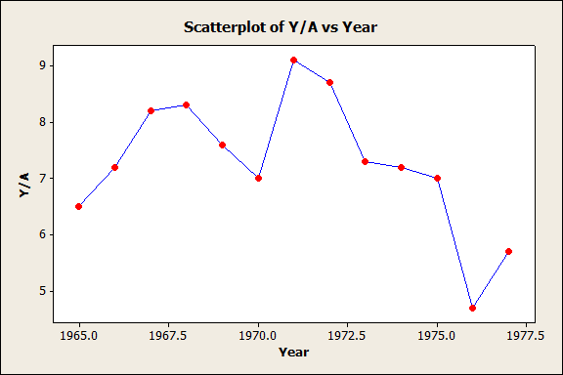
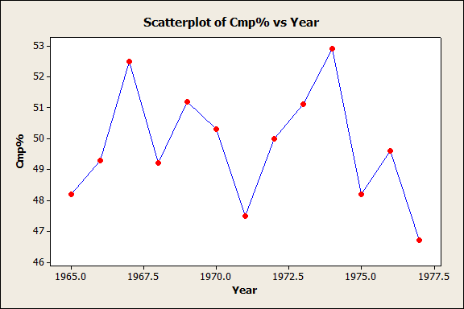
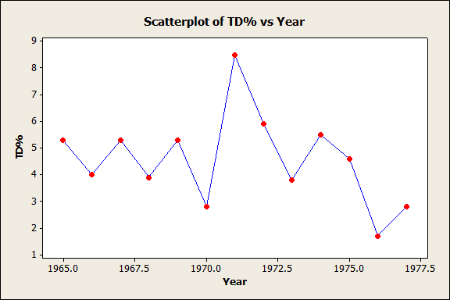
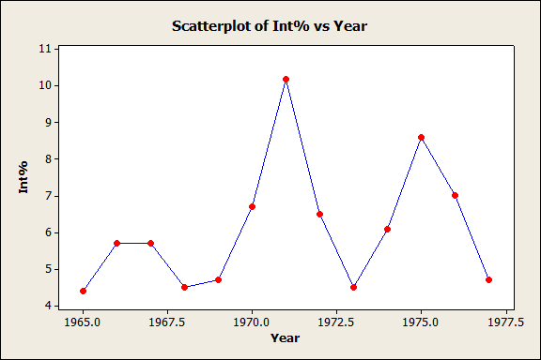
Joe Namath: Breakdown
Rating
Mean SE Mean StDev Minimum Q1 Median Q3 Maximum
63.88 2.95 10.64 39.90 54.60 68.70 72.30 74.30

Slide 7
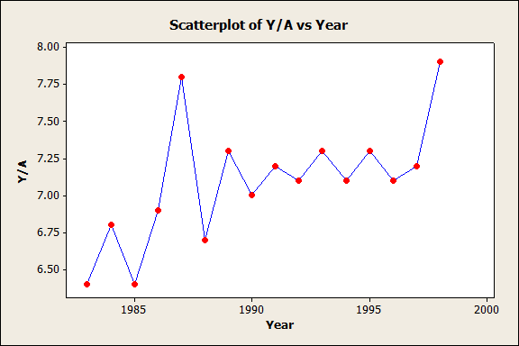
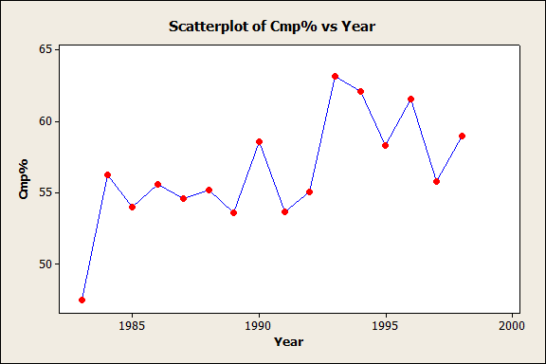
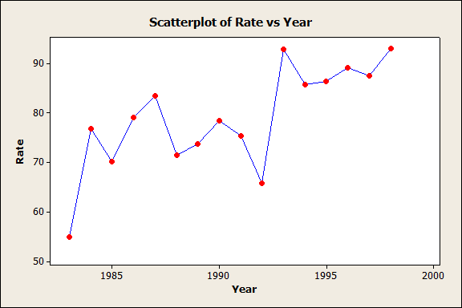
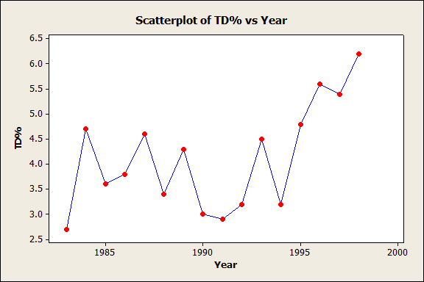
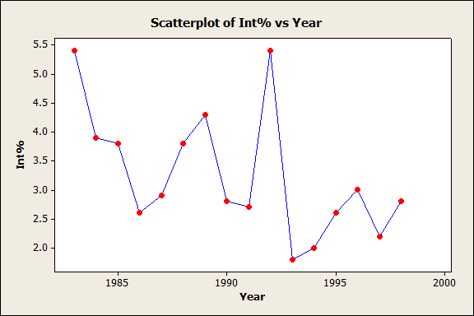
John Elway: Breakdown
RATING
Mean SE Mean StDev Minimum Q1 Median Q3 Maximum
78.97 2.60 10.39 54.90 71.98 78.75 87.22 93.00

Slide 8
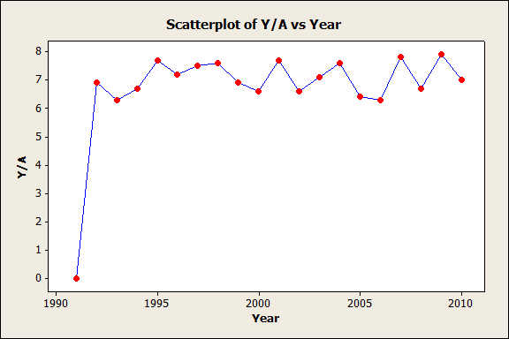
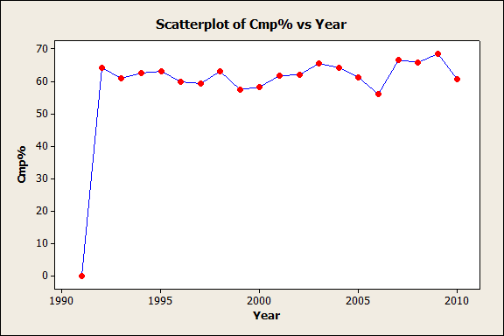
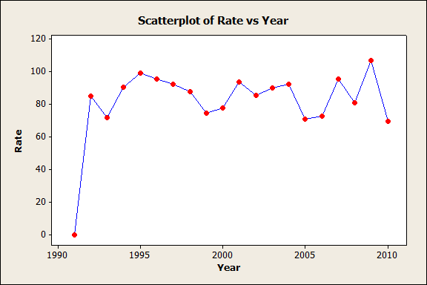
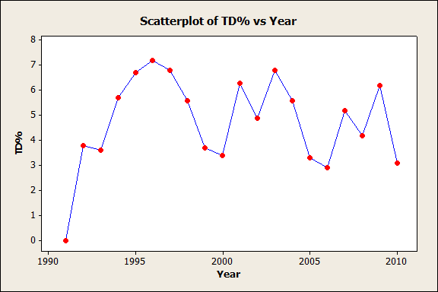
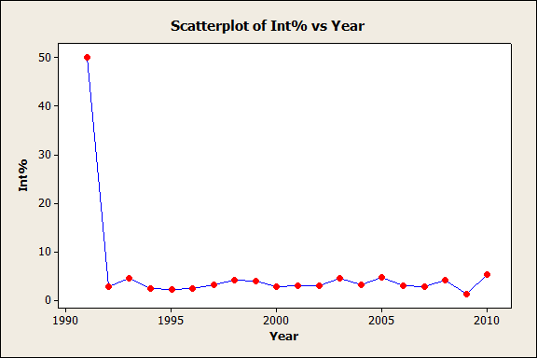
Brett Favre: Breakdown
RATING
Mean SE Mean StDev Minimum Q1 Median Q3 Maximum
81.83 4.90 21.93 0.00 73.20 86.70 93.72 107.20

Slide 9
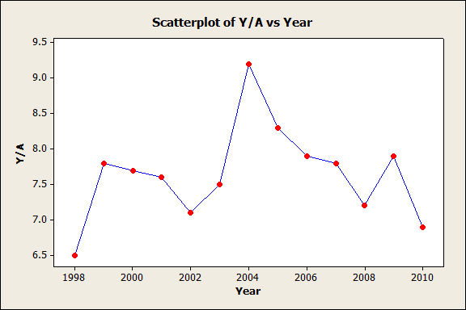
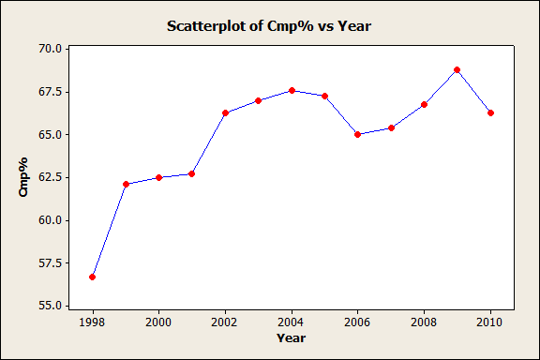
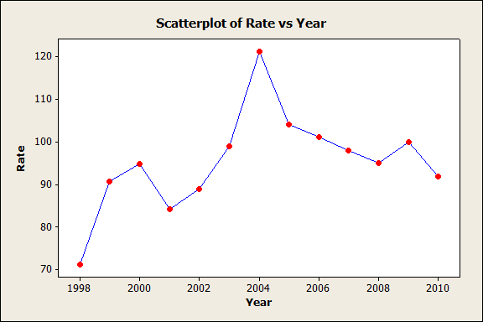
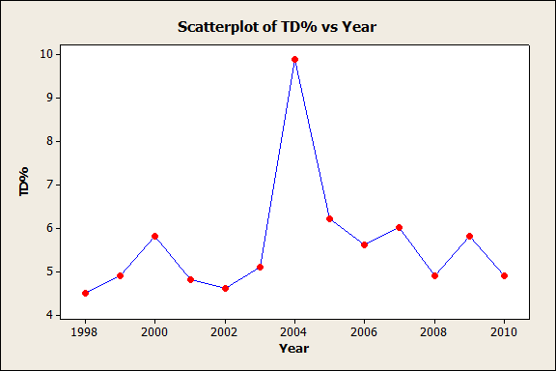
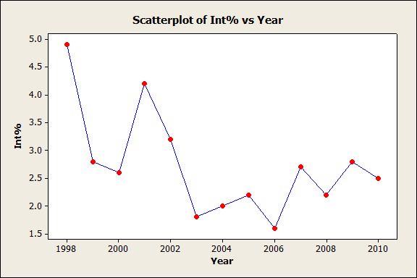
Peyton Manning: Breakdown
RATING
Mean SE Mean StDev Minimum Q1 Median Q3 95.35 3.20 11.54 71.20 89.75 95.00 100.45
Maximum 121.10

Slide 10
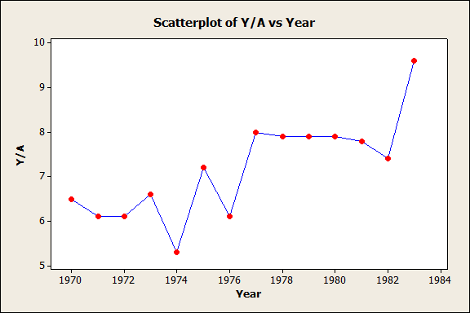
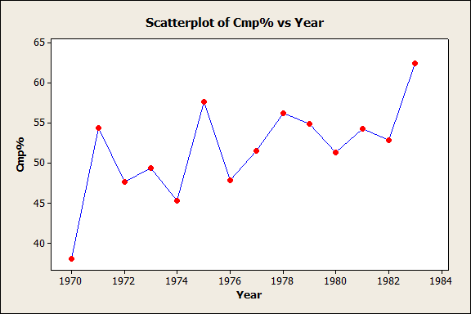
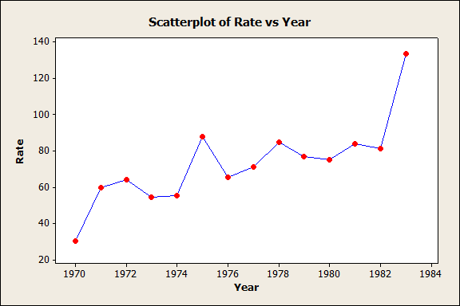
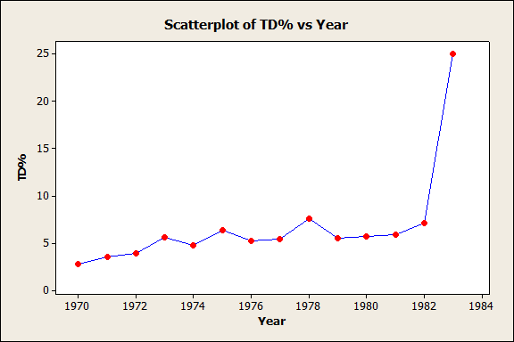
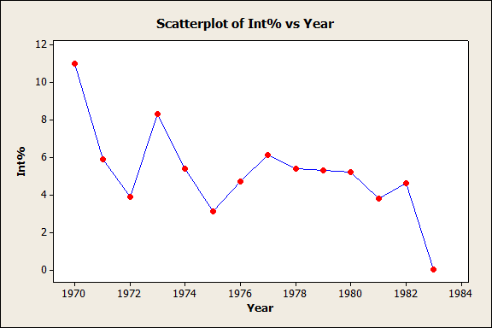
Terry Bradshaw: Breakdown
RATING
Mean SE Mean StDev Minimum Q1 Median Q3 Maximum 73.03 5.80 22.48 30.40 59.70 71.40 83.90 133.90

Slide 11
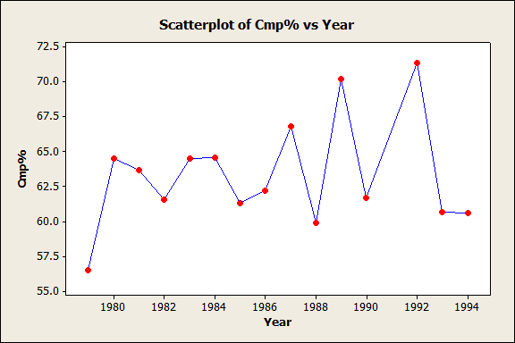
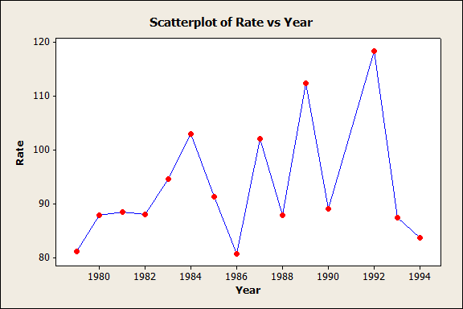
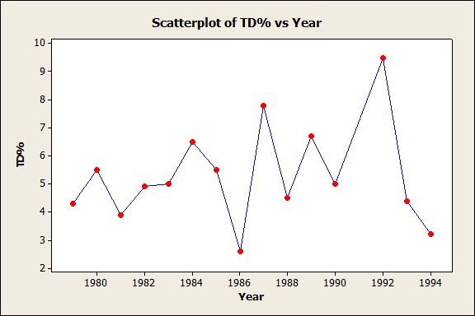
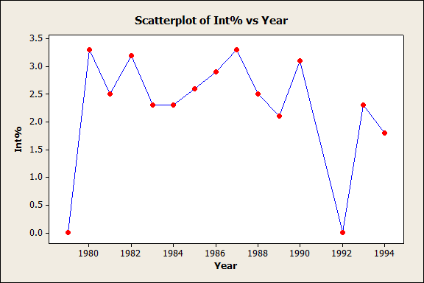
Joe Montana: Breakdown
RATING
Mean SE Mean StDev Minimum Q1 Median Q3 Maximum 92.58 2.42 10.28 80.70 86.80 88.70 96.47 118.40

Slide 12
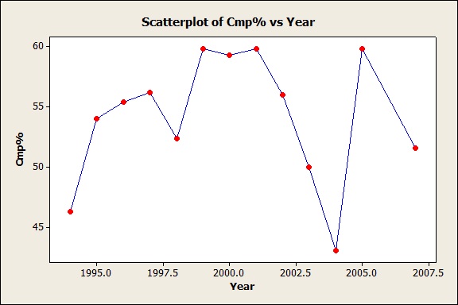
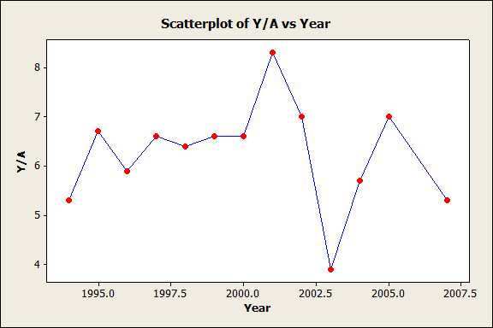
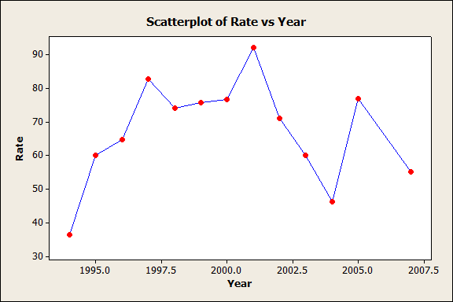
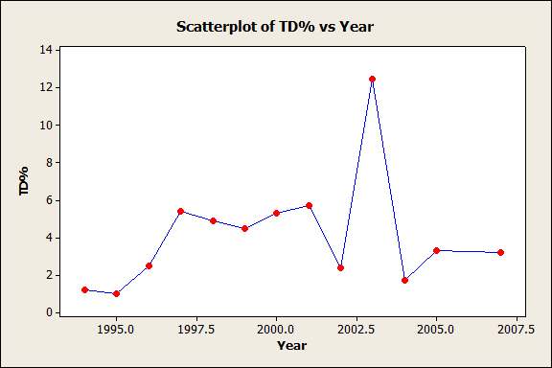
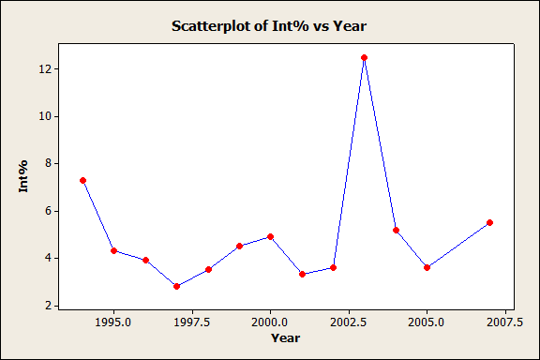
Trent Dilfer: Breakdown
RATING
Mean SE Mean StDev Minimum Q1 Median Q3 Maximum
68.07 3.06 13.34 36.30 59.90 71.10 76.60 92.00

Slide 13
Z-Scores:
Marino
Joe Namath
John Elway
Bret Favre
Peyton Manning
Terry Bradshaw
Joe Montana
Trent Dilfer
0.51626
-1.39767
-0.07898
0.47963
1.29465
-0.90316
1.05655
-0.96727

Slide 14
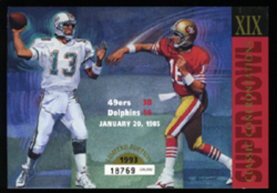
MARINO VS. MONTANA
Super Bowl XIX
86.4
92.3
0.51626
1.05655

Slide 15
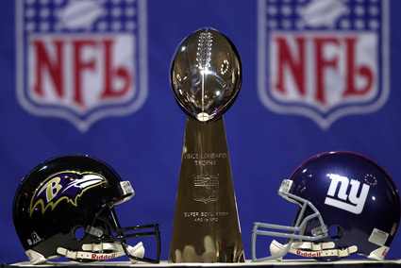
TRENT DILFER VS KERRY COLLINS
Super Bowl XXXV
70.2
73.9
-0.96727
-0.582746

Slide 16
BEN ROETHLISBERGER VS. AARON RODGERS
92.5
98.4

Slide 17
CONCLUSION
In comparing Dan Marino to other great QB’s who have won a Super Bowl, we attempted to discover if a great quarterback wins Super Bowls for a team or if it is more important to have a strong supporting cast.
We found that a great quarterback is not necessarily essential to winning a Super Bowl. Though a great QB is crucial to being a great team, as seen with Trent Dilfer, the QB alone does not win Super Bowls.

Slide 18
Sources
http://www.pro-football-reference.com/
http://espn.go.com/nfl/
Images from Google Images

